Slide 1
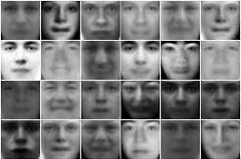
Generative Adversarial Network

Slide 2
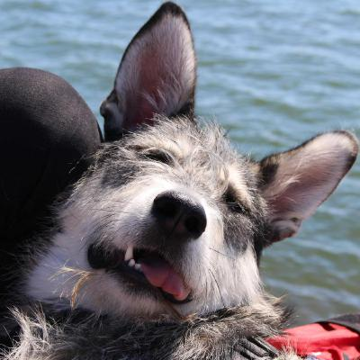
Image classifying ANN
Pr(y=”Dog”)

Slide 3
Data (image) generating ANN

Slide 4

Non-zero sum game
Zero sum game
win-win
Win
Lost
Win
Lost
what Player #1 wants
what Player #2 wants

Slide 5

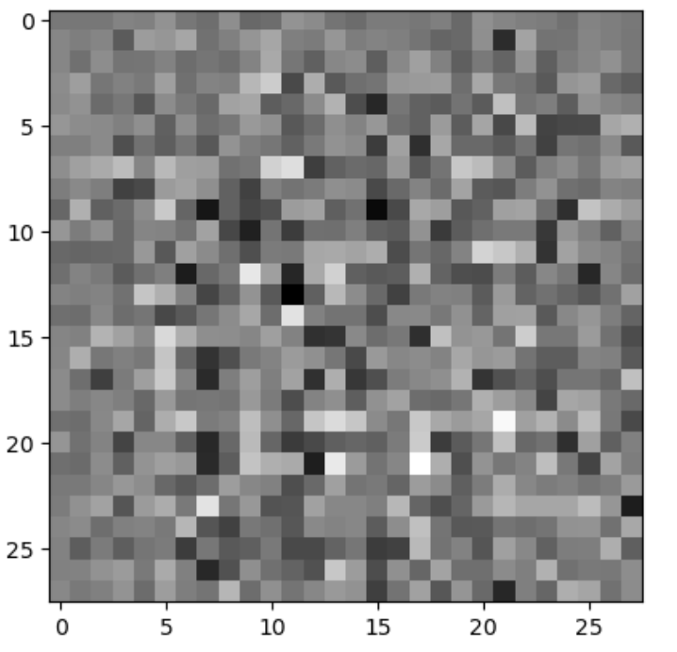
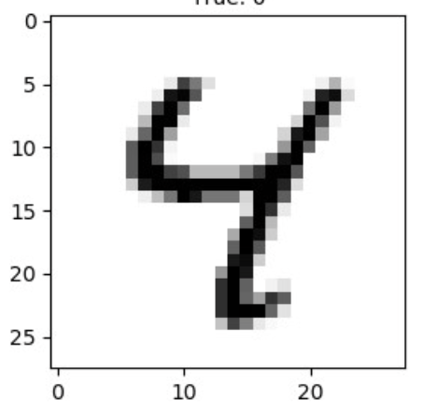
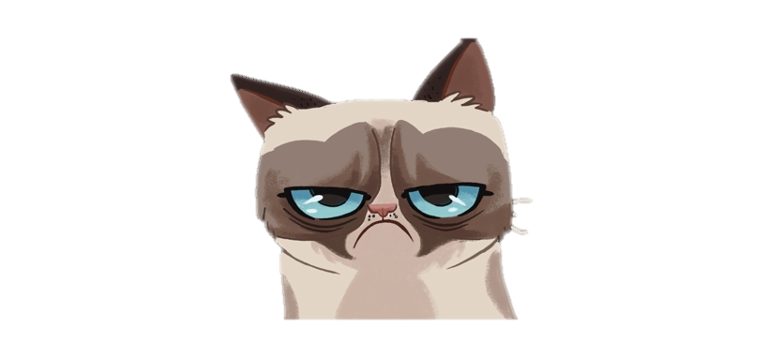
generated sample
targer sample
Generator
“Artist”
LOSE
“Fake!”
“Real!”
Discriminator
“Critic”
WIN

Slide 6
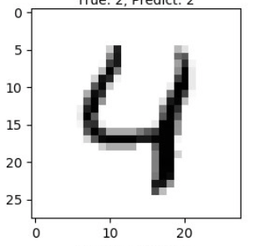
generated sample
training sample
Generator
“Artist”
WIN
“Real!”
“Real!”
Discriminator
“Critic”
LOSE

Slide 7
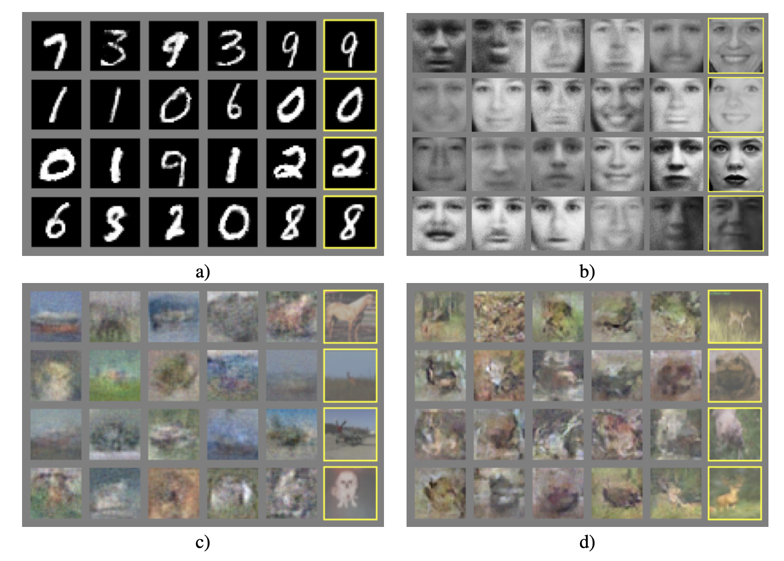
“Generative Adversarial Nets” Ian Goodfellow 2014

Slide 8
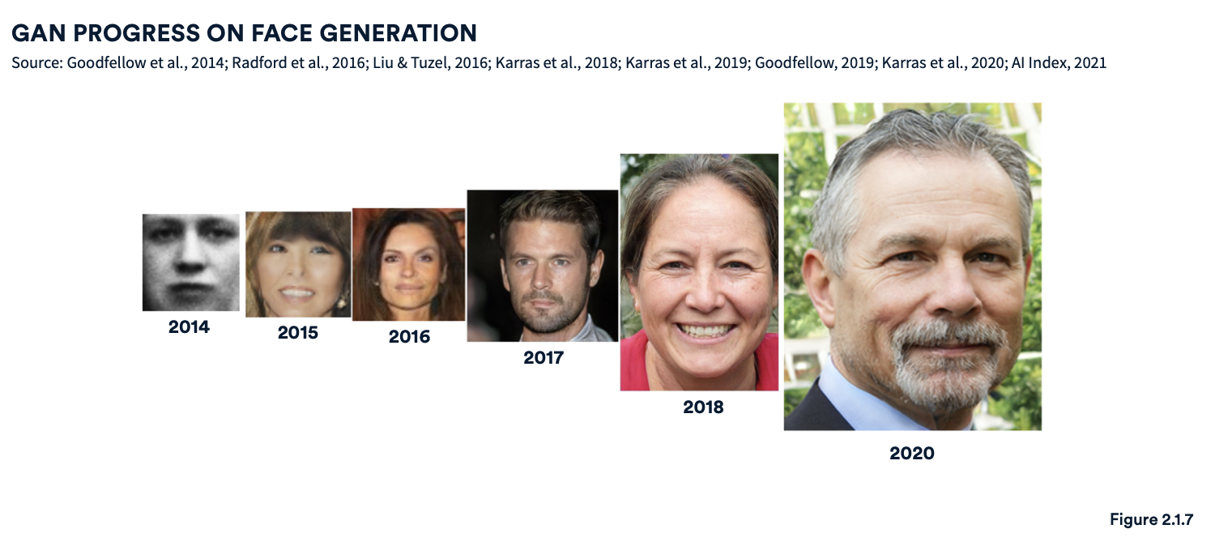
https://aiindex.stanford.edu/wp-content/uploads/2021/11/2021-AI-Index-Report_Master.pdf

Slide 9
https://thispersondoesnotexist.com

Slide 10
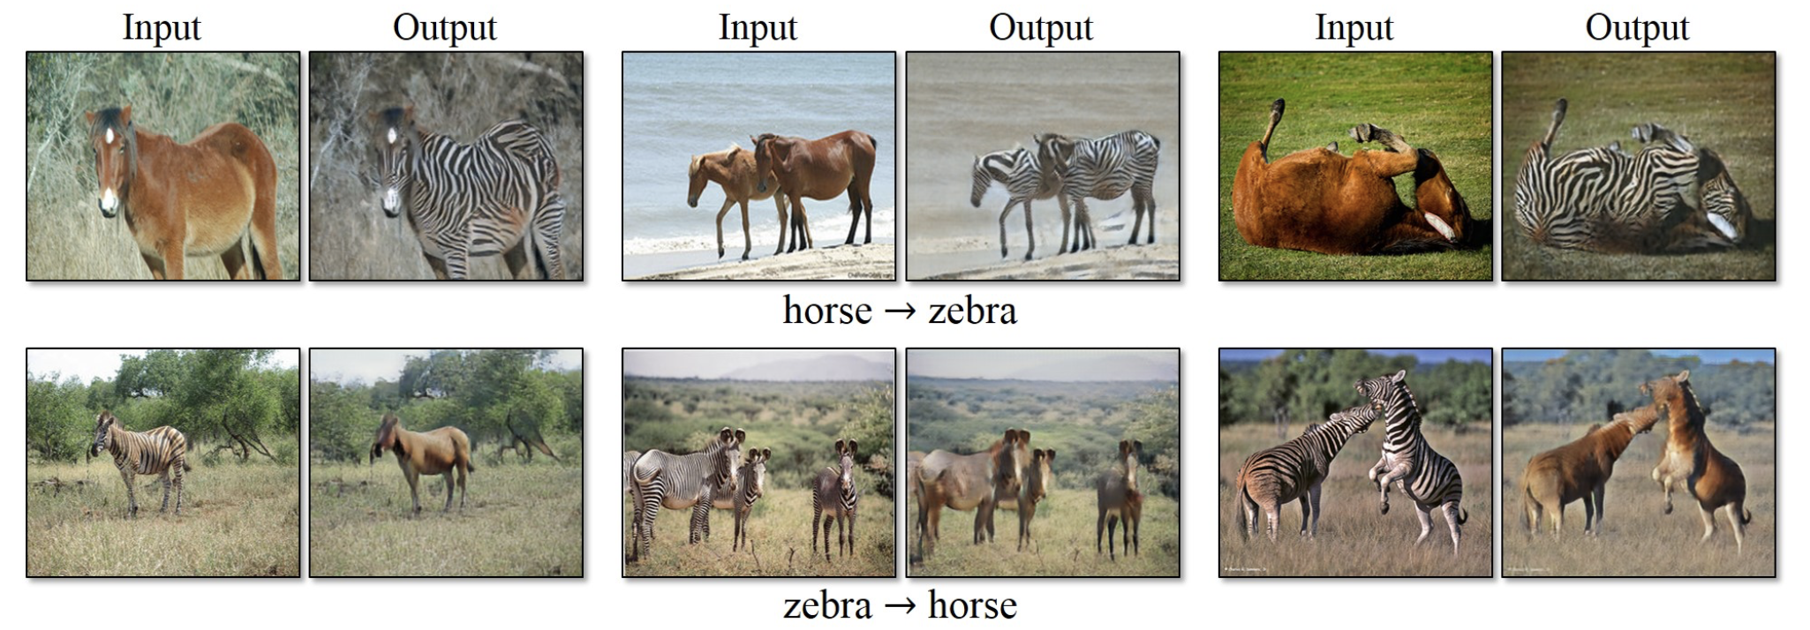
https://junyanz.github.io/CycleGAN/

Slide 11
Random
vector
Generator
Discriminator
Fake or
Real

Slide 12
codings_size = 100 # random vector
gen_out_size = 2 # shape of the generated sample
generator = tf.keras.models.Sequential([
tf.keras.layers.Dense(…, input_shape=[codings_size]),
tf.keras.layers.Dense(…),
tf.keras.layers.Dense(gen_out_size)
])
discriminator = tf.keras.models.Sequential([
tf.keras.layers.Dense(…, input_shape=[gen_out_size ]),
tf.keras.layers.Dense(…),
tf.keras.layers.Dense(1, activation=‘sigmoid’)
])

Slide 13
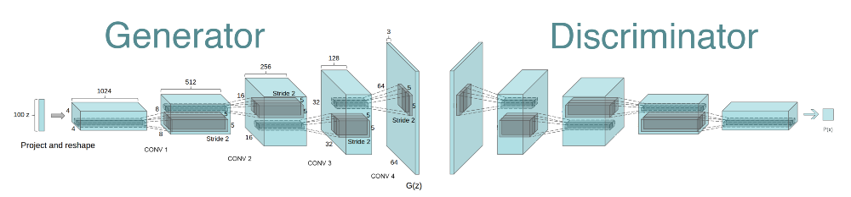
DCGAN – Deep Convolutional GAN

Slide 14

DCGAN – Convolution
output
input

Slide 15

DCGAN – Transposed convolution
output
input

Slide 16
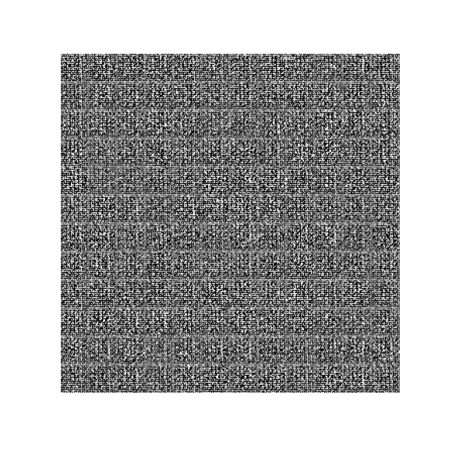
Hands on: Generation MNIST digits images

